Slide 1
Last Day Events that Lead to the Second Advent
By
Grace Mkwanazi

Slide 2
Signs that the end is near
Matthew 24:3- Disciples ask of the signs of His second advent.
Joel 2:30,31-Signsin the sun, moon and stars. E.g The Dark Day in October 19th 1780
Matthew 24:29- Signs in the sun, moon and stars

Slide 3
Falling stars in November 12th 1833

Slide 4
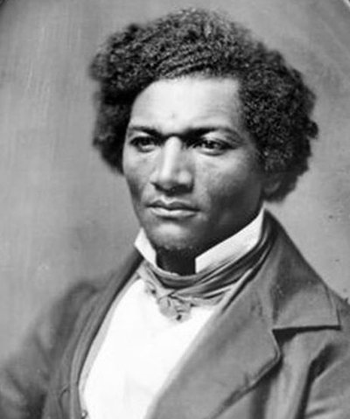
Eyewitness
“I witnessed this gorgeous spectacle, and was awestruck. The air seemed filled with bright descending messengers from the sky. It was about daybreak when I saw this sublime scene. I was not without the suggestion, at that moment that it might be the harbinger of the coming of the Son of Man; and in my then state of mind I was prepared to hail Him as my Friend and Deliverer. I had read that the ‘stars shall fall from heaven,’ and they were now falling. I was suffering very much in my mind. … I was looking away to heaven for the rest denied me on earth.”

Slide 5
Other signs
Matthew 24:37-39- Days before the Second coming like the days before the flood
2 Timothy 3: 1-5- Intense evil
2 Peter 3:3,4- Scoffing at the Second coming is itself a sign

Slide 6
How to prepare for Christ’s Second coming
Matthew 24:42- 44- Watch and be ready
Titus 2:11-13- Live soberly, righteously and godly
James 5:7-8 - Be patient
1 John 2:28 – Abide in Christ

